Slide 1





Modern JavaScript [ ES6++ ]
Writing
READING
SPEAKING
JOKING
// with Chayut Ruksomya

Slide 2
Table of content
What Node JS
NPM and package.json
JavaScript in nullshell

Slide 3


Slide 4
JavaScript
Runtime
Outside Web Browser

Slide 5
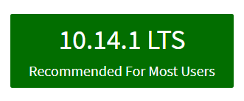
Install Node JS first
https://nodejs.org

Slide 6
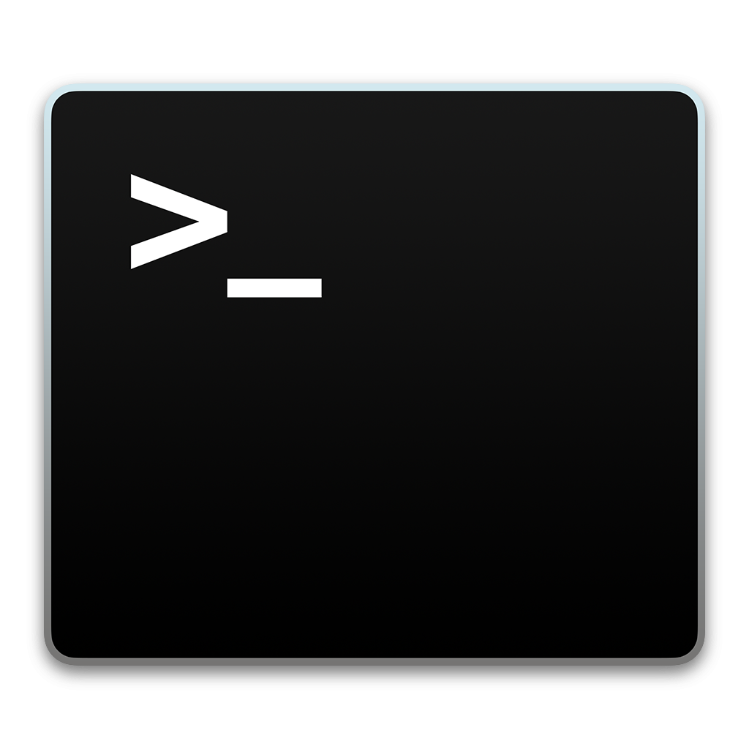
Verify
Installation
node -v

Slide 7
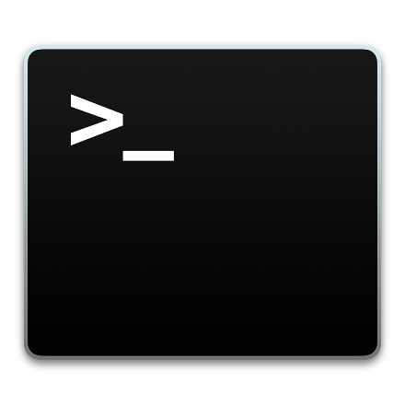
Code Example
CREATING SERVER USING JAVASCRIPT !!
var http = require('http');
var hostname = 'localhost';
var port = 3000;
var server = http.createServer(function (req, res) {
res.statusCode = 200;
res.setHeader('Content-Type', 'text/plain’);
res.end('hello from server!!');
});
server.listen(port, hostname, function () {
console.log('Server running at http://' + hostname + ':' + port);
});

Slide 8

Lab://001

Slide 9

Node Package Manager

Slide 10
The package manager for JavaScript and the world's largest software registry

Slide 11
What is npm?
Use npm to install, share, and distribute code; manage dependencies in your projects;

Slide 12
Verify
Installation
npm -v

Slide 13
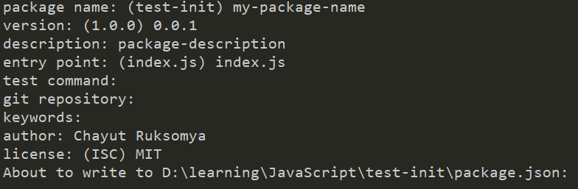
package.json and the very first npm command
npm init
// This command will create package.json file

Slide 14
{ "name": "my-package-name", "version": "0.0.1", "description": "package-description", "main": "index.js", "scripts": { "test": "echo \"Error: no test specified\" && exit 1" }, "author": "Chayut Ruksomya", "license": "MIT" }
package.json
The file in the root of your project source to use npm to install packages that your application requires (node modules).

Slide 15
To install dependency
npm install <package-name>
# or for short
npm i <package-name>
https://www.npmjs.com

Slide 16

Lab://002

Slide 17


ES2015
ECMAScript 2015

Slide 18
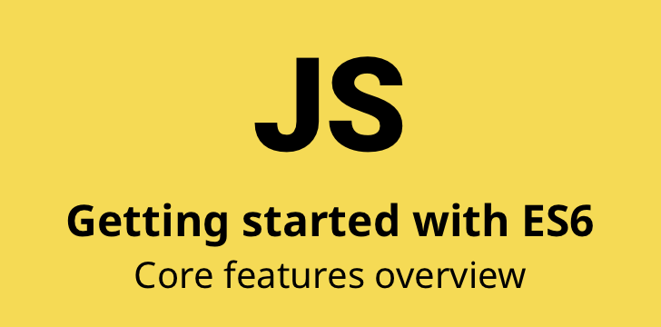
Intro to ES6

Slide 19
1. let var const
var -> function scope
let, const -> block scope

Slide 20
2. Template String
normal string “ ” or ‘ ’
Template String -> ` I’m template string ${JS expression} `
` -> Grave Accent

Slide 21
3. Arrow Function => ….
Traditional function syntax
Arrow function syntax(s)

Slide 22
4. rest and spread ( …variable )

Slide 23
5. destructuring

Slide 24
6. Functional programming??
Map
Filter
Reduce
Find

Slide 25

Lab://003

Slide 26
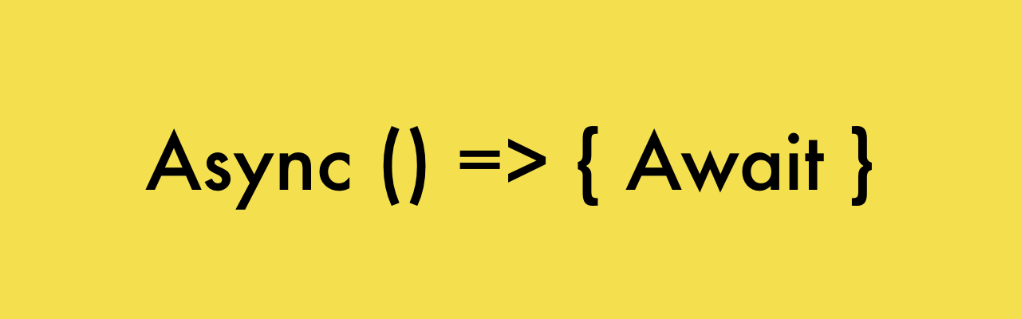
ES6 Advance

Slide 27
1. Callback VS Promise
Callback code
Promise code

Slide 28
2. Async Await
Async -> function
Await -> statement <- promise

Slide 29
3. Promise to Async await
Promise code
Async await code

Slide 30
4. Class

Slide 31
5. Import export modules ทำไงดี

Slide 32

Lab://004

Slide 33
transpilers
polyfill

Slide 34
Installation with npm นะ

